Slide 1
UNIT 3:
INSTALLATION
& MAINTENANCE

Slide 2
Overall Objectives
At the end of this unit, students will be able to:
- Clearly and accurately describe how to install computer software and hardware
- Basically describe computer maintenance procedures

Slide 3
SESSON 1:
- Clearly and accurately describe how to install computer software and hardware

Slide 4
Warm-up: Word-play
Objectives:
Students will be able to recall the words related to computer software and hardware installation.
Work in groups
Find the hidden words in the square (vertically, horizontally, diagonally). They may be upside-down or back to front.
Use the clues to help you

Slide 5



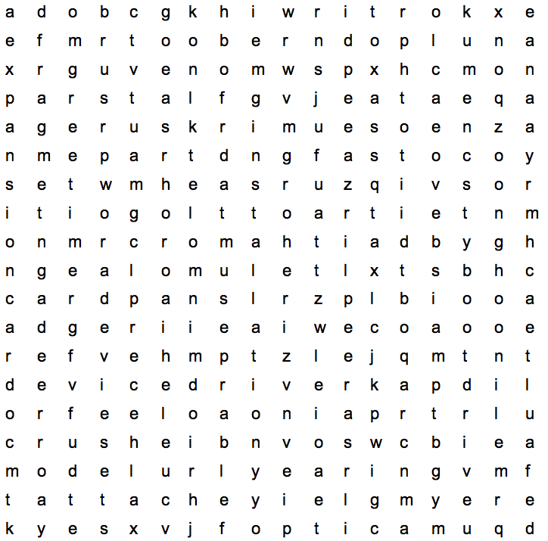
Warm-up: Word-play

Slide 6
1. the technical specifications of the computer such as processor speed, the amount of ram, hard drive space or the type of video card in the machine
2. a section of a storage device, such as a hard disk drive or solid-state drive
3. a printed circuit board that can be installed in a computer to add functionality to it
4. the process of making hardware and/or software ready for use
5. the drive that computer reads first when starting up
configuration
partition
expansion card
installation
boot drive

Slide 7
6. a software program that enables a specific hardware device to work with a computer's operating system
7. a device that allows images to be shown on a computer screen
8. an adjective that describes a standard setting or configuration
9. to fasten or join one thing to another
10. to switch the computer off and then start it again immediately
device driver
video card
default
attach
reboot

Slide 8
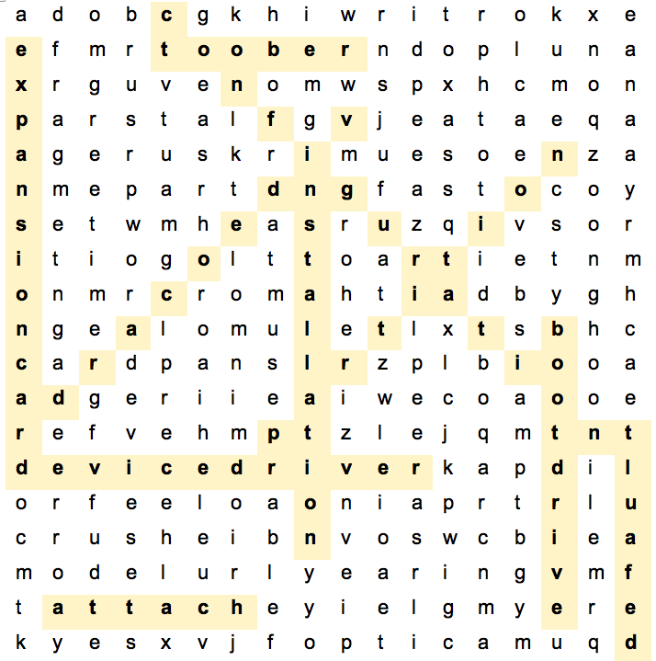
Warm-up: Word-play (Key)

Slide 9
Activity 1A: Matching
Objectives:
Students will be able to remember the verb phrases related to computer hardware and software installation.
Work in groups of four
Discuss and match the verbs (1-10) with the phrases (a-j)
Present to the class
Listen and give comments

Slide 10
Verbs | Phrases
1. configure | a. the hard drive
2. partition | b. the computer into a power source
3. attach | c. all important data before starting to reinstall the operating system
4. install | d. the BIOS
5. plug | e. the monitor, keyboard and mouse
6. transfer | f. the floppy drive with four screws
7. back up | g. RAM on the motherboard
8. reboot | h. data to memory
9. secure | i. the expansion card in the expansion slot
10. insert | j. the computer

Slide 11
Verbs | Phrases
1. configure | d. the BIOS
2. partition | a. the hard drive
3. attach | e. the monitor, keyboard and mouse
4. install | g. RAM on the motherboard
5. plug | b. the computer into a power source
6. transfer | h. data to memory
7. back up | c. all important data before starting to reinstall the operating system
8. reboot | j. the computer
9. secure | f. the floppy drive with four screws
10. insert | i. the expansion card in the expansion slot

Slide 12

Activity 2A: Ordering
Objectives:
Students will be able to identify basic steps in installing computer hardware and software.
Work in three groups
Discuss to put the following steps in the correct order
In turn, present to the class
Listen and give comments

Slide 13
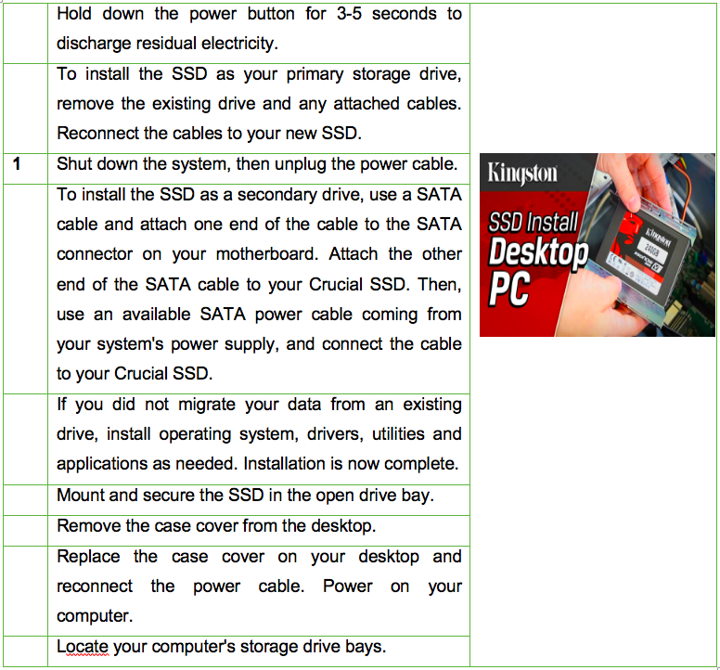
1. Steps to install an SSD in your desktop

Slide 14
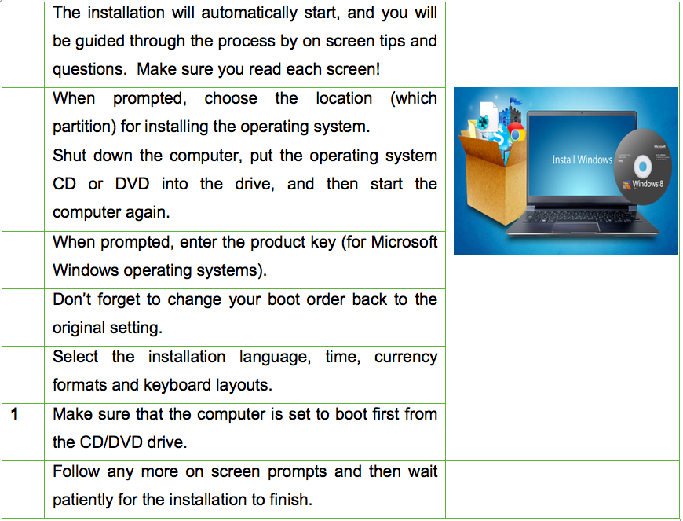
2. Steps in installing an operating system

Slide 15
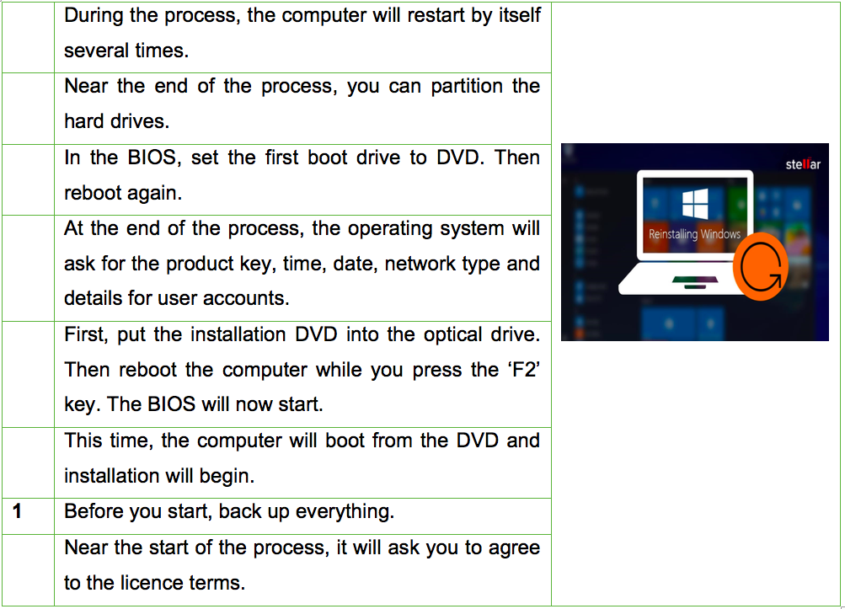
3. Steps in reinstalling an operating system

Slide 16

Suggested answer:

Slide 17
1. Steps to install an SSD in your desktop
 | Hold down the power button for 3-5 seconds to discharge residual electricity.
 | To install the SSD as your primary storage drive, remove the existing drive and any attached cables. Reconnect the cables to your new SSD.
1 | Shut down the system, then unplug the power cable.
 | To install the SSD as a secondary drive, use a SATA cable and attach one end of the cable to the SATA connector on your motherboard. Attach the other end of the SATA cable to your Crucial SSD. Then, use an available SATA power cable coming from your system's power supply, and connect the cable to your Crucial SSD.
 | If you did not migrate your data from an existing drive, install operating system, drivers, utilities and applications as needed. Installation is now complete.
 | Mount and secure the SSD in the open drive bay.
 | Remove the case cover from the desktop.
 | Replace the case cover on your desktop and reconnect the power cable. Power on your computer.
 | locate your computer's storage drive bays.
2
5
6
9
7
3
8
4

Slide 18
2. Steps in installing an operating system
 | The installation will automatically start, and you will be guided through the process by on screen tips and questions. Make sure you read each screen!
 | When prompted, choose the location (which partition) for installing the operating system.
 | Shut down the computer, put the operating system CD or DVD into the drive, and then start the computer again.
 | When prompted, enter the product key (for Microsoft Windows operating systems).
 | Don’t forget to change your boot order back to the original setting.
 | Select the installation language, time, currency formats and keyboard layouts.
1 | Make sure that the computer is set to boot first from the CD/DVD drive.
 | Follow any more on-screen prompts and then wait patiently for the installation to finish.
3
6
2
5
8
4
7

Slide 19
3. Steps in reinstalling an operating system
 | During the process, the computer will restart by itself several times.
 | Near the end of the process, you can partition the hard drives.
 | In the BIOS, set the first boot drive to DVD. Then reboot again.
 | At the end of the process, the operating system will ask for the product key, time, date, network type and details for user accounts.
 | First, put the installation DVD into the optical drive. Then reboot the computer while you press the ‘F2’ key. The BIOS will now start.
 | This time, the computer will boot from the DVD and installation will begin.
1 | Before you start, back up everything.
 | Near the start of the process, it will ask you to agree to the licence terms.
6
7
3
8
2
4
5

Slide 20
Activity 3A: Giving instructions
Objectives:
Students will be able to talk about steps in installing computer hardware and software based on given suggestions.
Work in pairs
Take turns being an IT helpdesk technician and an IT user
Instruct your partner on how to install Windows 10 based on the suggested pictures
Present to the class
Listen and give comments

Slide 21
Suggested answer:

Slide 22
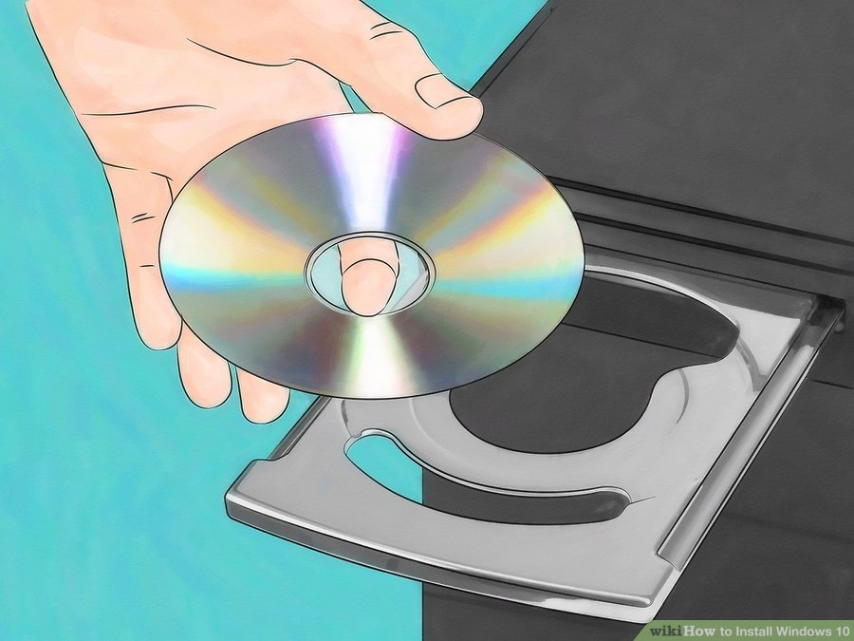
Step 1
Insert the disc or flash drive into your computer. Boot your computer using the installation DVD or USB flash drive with the Windows 10 installation. As soon as you boot, you see a quick message on the screen stating that you need to press any key to continue. Press any key on your keyboard, and the installation wizard is shown.

Slide 23
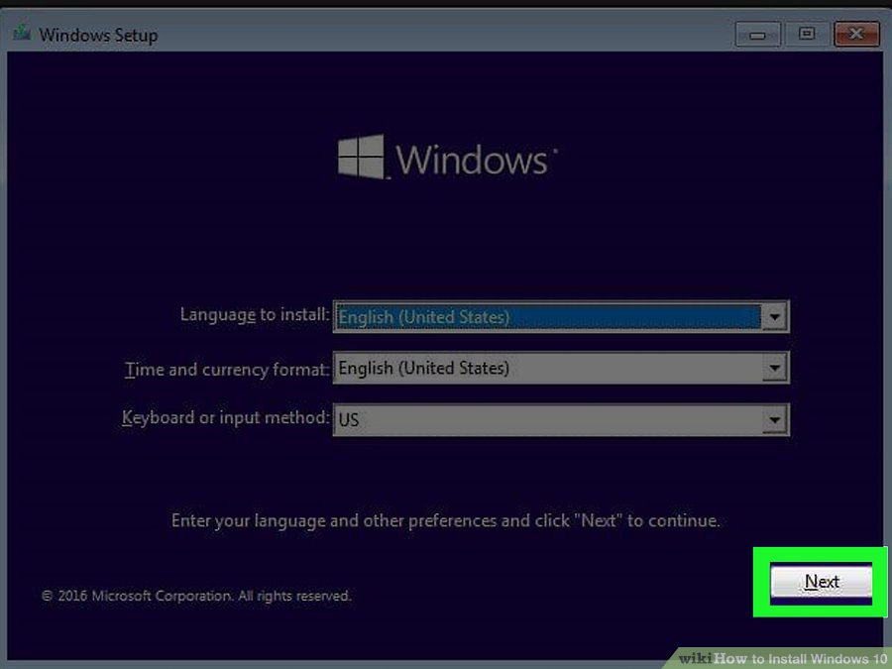
Step 2
Select a language, time and keyboard setting, then click Next.

Slide 24
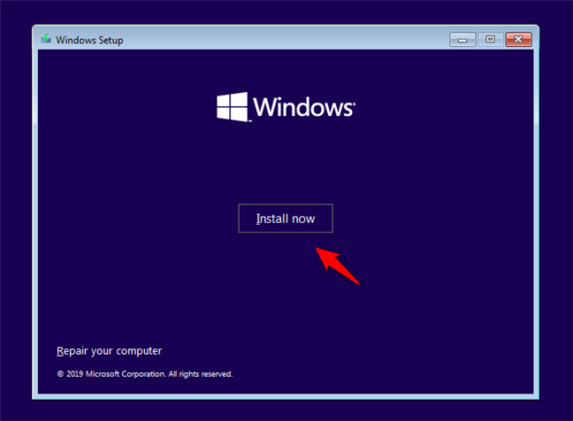
Step 3
Click or tap Install Now to start the installation.

Slide 25
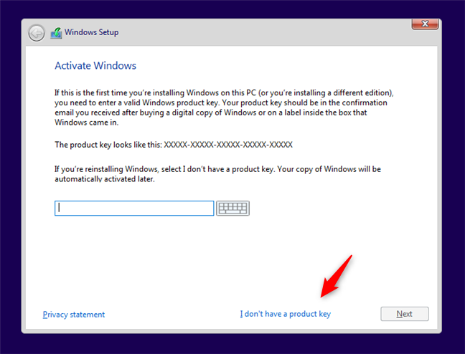
Step 4
Enter your Windows 10 key, then click Next. If you don't have a Windows 10 key, instead click Skip in the bottom-right corner of the screen.

Slide 26
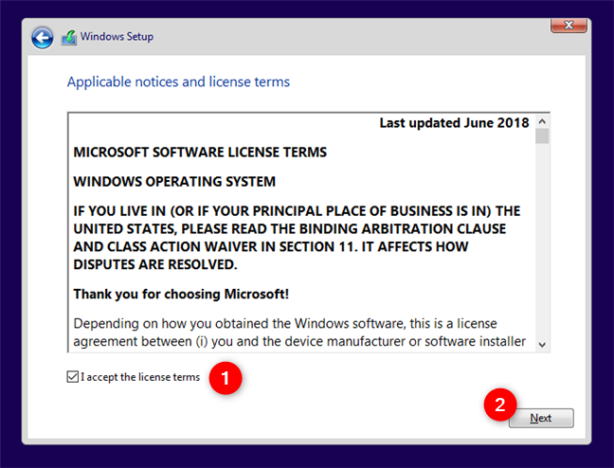
Step 5
You are shown the license terms. Click or tap the "Accept" box and click Next. This will indicate that you accept the terms of use.

Slide 27
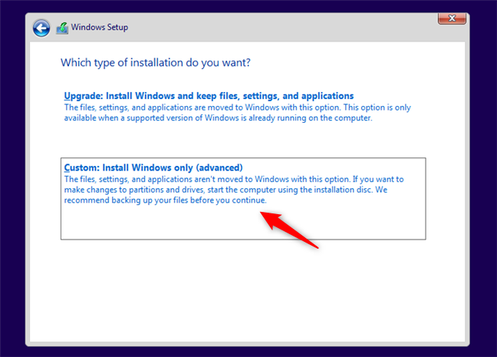
Step 6
You are asked for the type of installation you want to perform. As you are installing Windows 10 from scratch, click or tap "Custom: Install Windows only (advanced)."

Slide 28
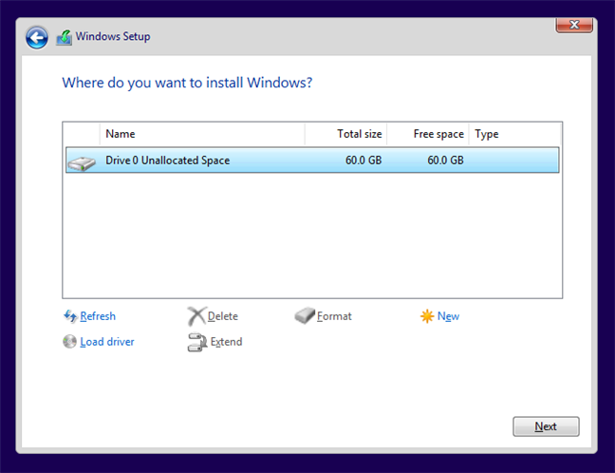
Step 7
Now you are asked to select where you want to install Windows. Choose the drive or partition that you want to use for Windows 10 and press Next.

Slide 29
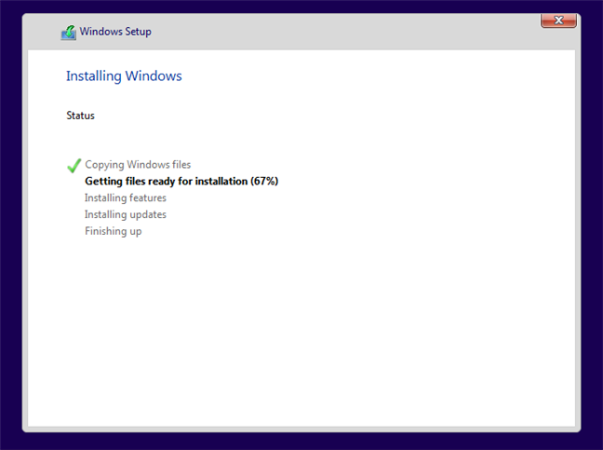
Step 8
The setup takes some minutes to copy all the required files and then installs the Windows 10 operating system. It also installs updates, if it detects that it can connect to the internet.

Slide 30
Step 9: Follow any more on screen prompts and then wait patiently for the installation to finish.

Slide 31
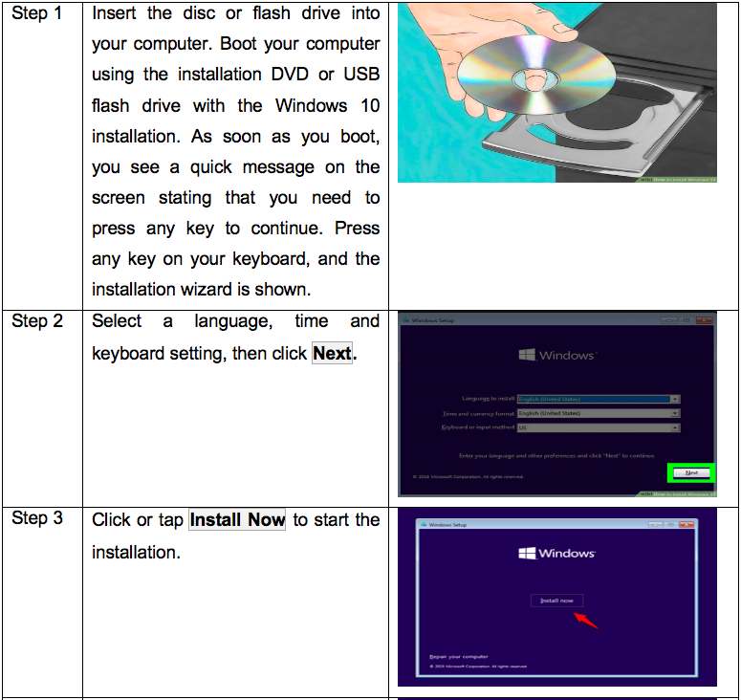

Slide 32
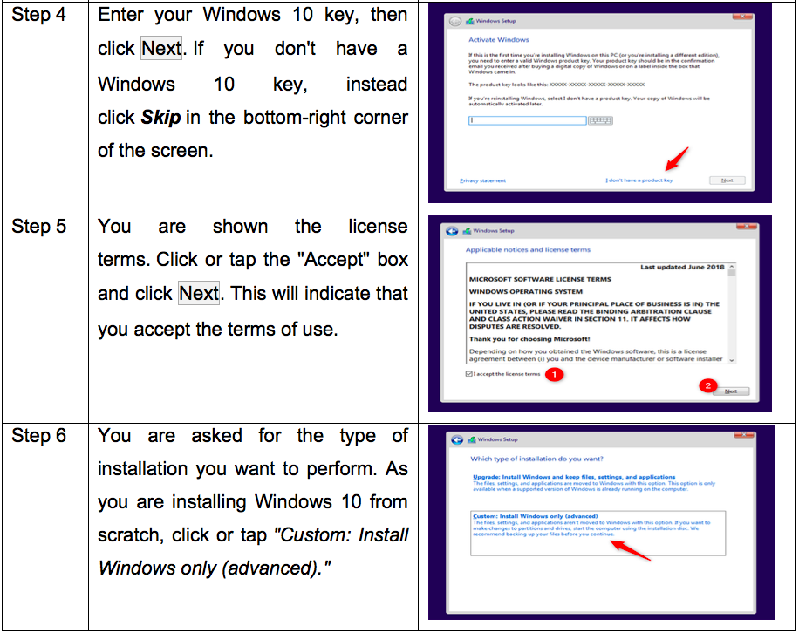

Slide 33
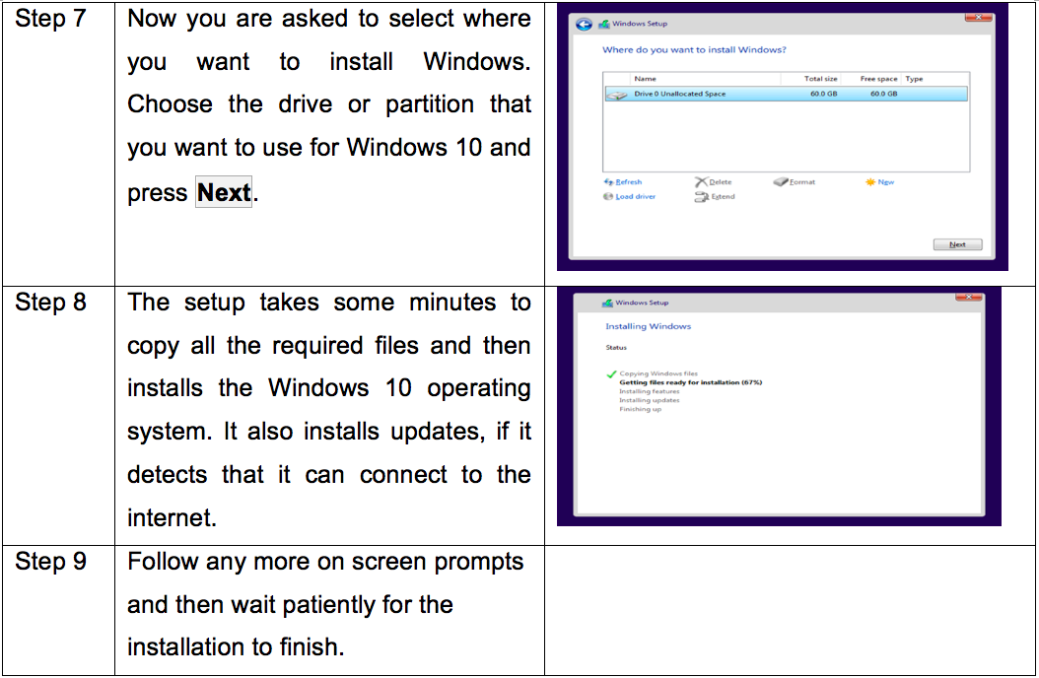

Slide 34
SESSON 2:
- Basically describe computer maintenance procedures

Slide 35
Activity 2A: Bankruptcy
Objectives:
Students are able to remember the function and features of the components inside the computer system
Game – Bankruptcy:
Work in two groups
Take turn to choose the question and answer
Each correct answer a certain amount of money
“Lucky number” doubled
“Half” halved
“Bankrupt” lose all money
“Vice versa” all the money of opponent belongs to you and vice versa
The team with higher amount of money will be the winner

Slide 36



















Game - Bankruptcy

Slide 37

Complete the sentence with a suitable word beginning with a given letter.
1. D_ _ _ c_ _ _ _ _ _ allows users to remove files that are no longer needed or that can be safely deleted.
Disk cleanup
-

Slide 38

Complete the sentence with a suitable word beginning with a given letter.
2. M_ _ _ _ _ _ _ _ D_ _ _ _ O_ _ _ _ _ _ _ _ is a utility in Microsoft Windows designed to increase access speed by rearranging files stored on a disk to occupy contiguous storage locations.
Microsoft Drive Optimizer

Slide 39

Complete the sentence with a suitable word beginning with a given letter.
3. R_ _ _ _ _ d_ _ _ _ are commonly used to remove viruses from computers when it is impossible to use Safe Mode.
Rescue disks

Slide 40

Complete the sentence with a suitable word beginning with a given letter.
4. When you start to hear extra grinding sounds, or your computer doesn't open files as quickly as it did before, it's time to d_ _ _ _ _ _ _ _ _.
defragment
-

Slide 41


Slide 42

Complete the sentence with a suitable word beginning with a given letter.
6. P_ _ _ _ _ _ _ _ _ _ _ a disk can make it easier to organize files, such as video and photo libraries, especially if you have a large hard drive.
Partitioning

Slide 43

Complete the sentence with a suitable word beginning with a given letter.
7. To c_ _ _ _ _ _ _ _ the desktop, select Start > Control Panel > Display or right-click the mouse on a vacant area of the desktop and choose Properties from the pop-up menu.
configure
-

Slide 44

Complete the sentence with a suitable word beginning with a given letter.
8. A computer needs to be m_ _ _ _ _ _ _ _ _ on a regular basis in order to keep everything working properly.
maintained

Slide 45


Slide 46

Complete the sentence with a suitable word beginning with a given letter.
10. If you b_ _ _ u_ your iPhone, iPad, or iPod touch, you’ll have a copy of your information to use in case your device is ever replaced, lost, or damaged.
back up

Slide 48
Complete the sentence with a suitable word beginning with a given letter.
12. You can o_ _ _ _ _ _ _ your hard drives to help your computer run more efficiently, or analyze them to find out if they need to be optimized.
optimize
-

Slide 49
Complete the sentence with a suitable word beginning with a given letter.
13. D_ _ _ _ _ M_ _ _ _ _ _ is a Control Panel applet in Microsoft Windows operating systems, which allows users to view and control the hardware attached to the computer.
Device Manager

Slide 50


Slide 51
Complete the sentence with a suitable word beginning with a given letter.
15. To improve the computer's performance, you can add e_ _ _ _ _ _ _ _ c_ _ _ _ such as video card or sound card.
expansion cards
-

Slide 53


Slide 54
Complete the sentence with a suitable word beginning with a given letter.
18. C_ _ _ s_ _ _ _ normally does not need to be changed, except when there is a problem with hardware or a new hard drive or floppy drive is installed
CMOS setup

Slide 55
Activity 1B: Who’s faster?
Objectives:
Students will be able to revise the first conditional, imperatives and structures to give reasons and purposes.
Work in two groups
Make sentences based on the pictures and given information
Say ‘BINGO’ to give your answer
Get 1 point for correct answer
The team with higher score will be the winner

Slide 56
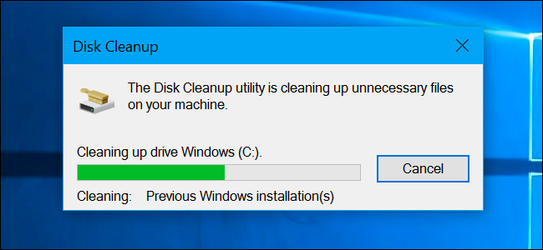
1. Regularly run …………………… (to)
1. Regularly run Disk Cleanup to delete unnescessary files on your computer.

Slide 57
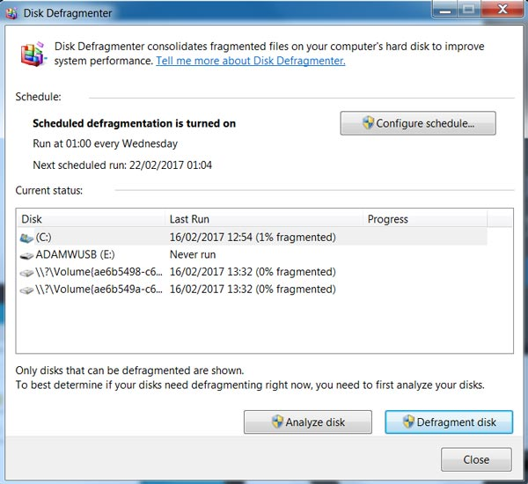
2. Run the Disk Defragmenter in order to clean up your computer and improve system performance.
2. Run the ………………………….. (in order to)

Slide 58
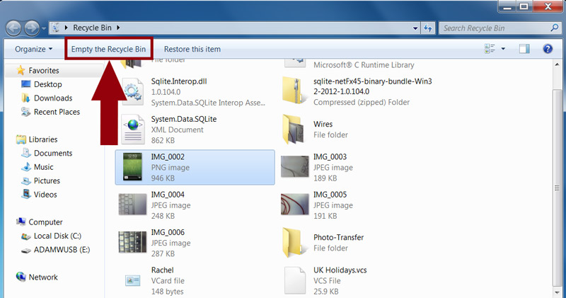
3. If you are sure that you’d like to remove all the files in Recycle Bin, click ‘Empty the Recycle Bin’ to permanently delete all of the files.
3. If you are sure that you would like ………. ………………………………. (If/to)

Slide 59
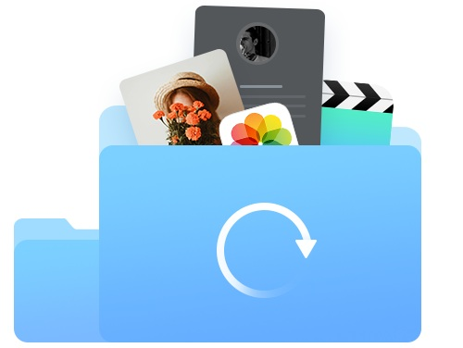
4. Back up ……………………………….. (for)
4. Back up everything/all your data for safety.

Slide 60
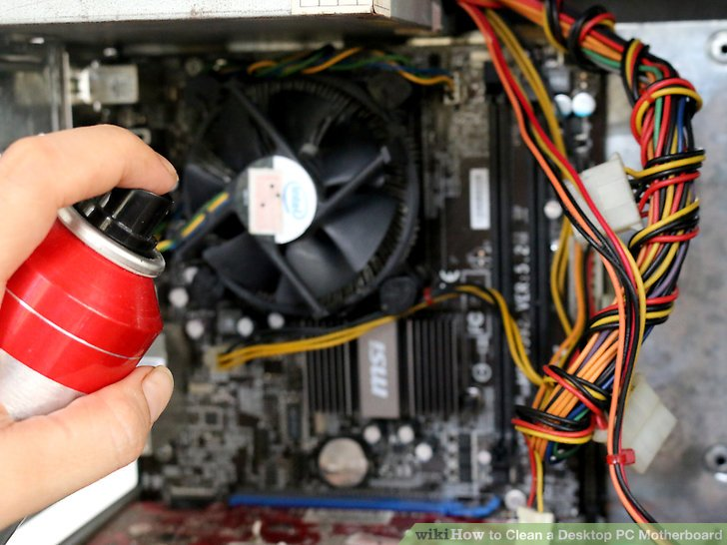
5. Use compressed air ……………………(to)
5. Use compressed air to blow the dust out of the case.

Slide 61
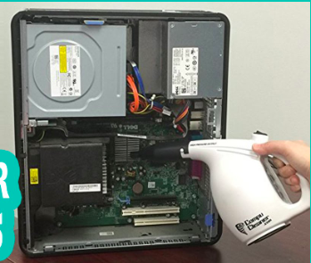
6. …………………………….., use a vacuum to suck out the dust. (If)
6. If the vents look clogged with dust, use a vacuum to suck out the dust.

Slide 62
Activity 2B: Making a conversation
Objectives:
Students will be able to make conversations about computer maintenance.
Work in pairs
Play the roles of an IT expert and a trainee to make conversations about computer maintenance
Present to the class
Listen and give comments

Slide 63
Student A: You are an IT expert. A trainee in your computer wants you to explain to him/her about computer maintenance. Make conversation based on the given information in the card below.

Slide 64
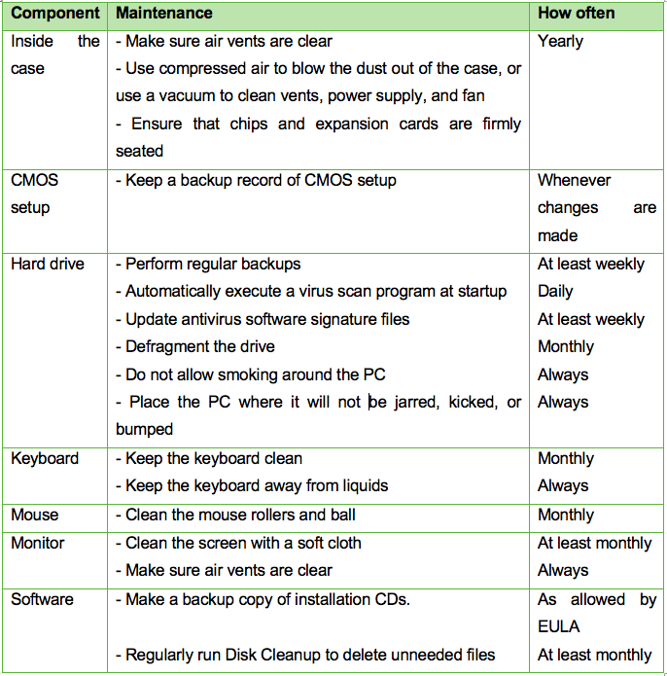

Slide 65
Student B: You are a trainee in ABC company. You want to understand about computer maintenance so you ask an IT expert to help you. Make conversation based on the given information below.
Information needed to ask:
Name of components needed to be maintained
Tips to maintain the CMOS setup
Tips to maintain the software
Maintenance activities needed to be done monthly
Maintenance activities needed to be done yearly

Slide 66
Sample:
B: Good morning, sir. I’m A, a trainee in ABC company. Can you share me some tips to maintain a computer?
A: Yes, of course.
B: So what components should be maintained?
A: Well, we must maintain most of components such as hard drive, keyboard, mouse, monitor, software, components inside the case, CMOS setup… to make sure that the whole computer runs well.
B: …
A: …

Slide 67
Suggested answer:
B: Good morning, sir. I’m A, a trainee in ABC company. Can you share me some tips to maintain a computer?
A: Yes, of course.
B: So what components should be maintained?
A: Well, we must maintain most of components such as hard drive, keyboard, mouse, monitor, software, components inside the case, CMOS setup… to make sure that the whole computer runs well.
B: Can you tell me what should be done to maintain the CMOS setup?
A: Remember to keep a backup record of CMOS setup whenever changes are made.

Slide 68
B: So what should be done to maintain the software?
A: First, you should make a backup copy of installation CDs as allowed by EULA. Second, regularly run Disk Cleanup to delete unneeded files at least once per month.
B: What maintenance activities need to be done monthly?
A: You should defragment the hard drive every month to make your computer operate smoothly. In addition, we need to keep the keyboard clean and clean the mouse rollers and ball everymonth. It’s also necessary to clean the screen with a soft cloth at least once a month.
B: Well, that’s such useful information. Thank you for sharing with me.
A: You’re welcome.

Slide 69

Activity 3B: Free talk
Objectives:
Students will be able to describe their favorite website.
Work individually
Talk about how to maintain a computer based on the suggested questions
Present to the class
Listen and give comments

Slide 70
Activity 3B: Free talk
Suggested questions:
1. What computer components are maintained?
2. How often is each component maintained?
3. What activities are done in each component’s maintenance?
4. What is the most important activity in computer maintenance?
5. Why is the maintenance necessary?

Slide 71
Outline
Opening: Computer maintenance is very important for keeping your computer running smoothly.
Components: internal components such as power supply, fan, heat sink, motherboard, hard drive,… and external components like mouse, keyboard, monitor, …Maintaining software is also necessary.
Activities:
Internal components: use a compressed air to blow the dust out of the case or use a vacuum or a dry cloth to clean vents, power supply, hard drive, motherboard, heat sink and fan. To keep your computer running cool, you should clean the inside parts of your computer every 6 to 12 months.
External components: use a damp cloth to clean your monitor screen and remove dust/skin flakes from your keyboard and mouse. Remember to always keep the monitor, keyboard and mouse clean and away from liquids.
Software: always have your firewall running, regularly run antivirus and spyware scan, update the operating system periodically, frequently remove unnecessary programs, defragment the hard drive and run disk cleanup to delete unneeded files,…
Why => Important: by keeping your computer in great shape with maintenance, it can extend the life of your computer.

